Slide 1



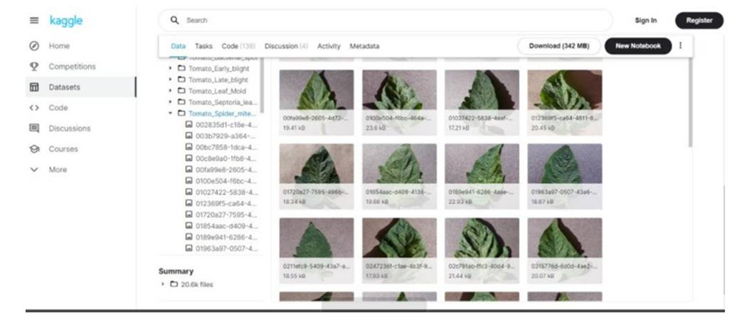
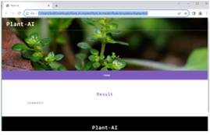
PLANT HEALTH MANAGEMENT:CNN FOR DISEASE DETECTION& TREATMENT RECOMMENDATIONS
Department of Computer Science & Engineering
School of Computing
10214CS602 – MINOR PROJECT-II
WINTER SEMESTER 2023-2024
ABSTRACT
INTRODUCTION
RESULTS
STANDARDS AND POLICIES
Plant diseases loom large, threatening crop yields and livelihoods. Identifying the culprit and finding the right cure, often chemical-laden, can be a confusing struggle. This is where our innovative system steps in, offering a helping hand by blending the power of artificial intelligence with the wisdom of organic solutions. Imagine holding your smartphone over a sickly leaf. The system within, armed with a trained eye called a Convolutional Neural Network (CNN), analyzes the image, meticulously comparing it to a vast library of diseased and healthy leaves. This CNN, a master of pattern recognition, quickly pinpoints the culprit, revealing the disease afflicting your precious plant
Plant diseases pose a persistent threat to agriculture, causing massive crop losses and jeopardizing food security. Early and accurate diagnosis is crucial for mitigating these harms, but traditional methods can be time-consuming, subjective, and often require chemical solutions with undesirable environmental and health consequences. In response, we introduce a novel system that leverages the power of artificial intelligence and organic wisdom to revolutionize plant leaf disease detection and treatment
Imagine capturing a photo of your ailing plant with your smartphone. Our system instantly analyzes the image using a deep learning model that recognizes disease patterns with remarkable accuracy. This diagnosis unlocks a treasure trove of organic treatment methods curated by agricultural experts, tailored to the specific disease and plant species. With clear, accessible instructions utilizing readily available materials, empowering you to effectively treat your plants while promoting sustainable practices. This is just the beginning, as we envision a future where the system continuously learns, expands its knowledge base, and adapts to real-time field applications, ultimately fostering a healthier future for agriculture and the environment
The proposed system shines when it comes to efficiency. Its deep learning engine boasts high accuracy, potentially hitting 90 percent above, even tackling diverse diseases and species. This reliable diagnosis empowers farmers to act quickly, saving crops and minimizing losses. Plus, the system learns and adapts continuously, staying relevant against new or rare threats.But efficiency goes beyond accuracy. Imagine capturing a leaf picture on your phone and getting a diagnosis within minutes – our mobile app potential makes it convenient and accessible.
Adhere to data privacy laws, ethical AI practices, and agricultural regulations for responsible implementation. Ensure accessibility, transparency, and collaboration with research institutions to align with standards and contribute to sustainable and inclusive crop disease detection practices. Continuous monitoring and adherence to local community needs further enhance the project's ethical and effective impact.
CONCLUSIONS
The battle against plant disease takes a significant turn with our proposed system. By harnessing the precision of deep learning and the wisdom of organic solutions, we offer a powerful tool for early diagnosis and sustainable management. Farmers are empowered with accurate disease identification at their fingertips, enabling decisive action before losses mount.But our vision extends beyond mere accuracy. By prioritizing readily available materials and eco-friendly methods, we pave the way for accessible and sustainable treatments.
Fig : Input Image For Processing
TEAM MEMBER DETAILS
METHODOLOGIES
1. Vtu 20507/YAMBALURU HARSHA DEEPAK
2. Vtu19916/NIRANJAN PEEKA
3. Vtu19923/BANDARI HEMANTH
1. 7382963951
2. 9515327903
3. 9553622168
1. vtu20507@veltech.edu.in
2. vtu19916@veltech.edu.in
3. vtu19923@veltech.edu.in
Step 1: Capture images of crop plants affected by diseases in the field
Step 2: Preprocess the images to enhance quality:
Apply image enhancement techniques for improved visual clarity.Utilize a Gaussian filter for image smoothing.
Step 3: Detect crop diseases through feature extraction and classification
Step 4: Quantify disease severity and affected area
Step 5: Provide actionable insights and recommendations
ACKNOWLEDGEMENT
Supervisor Name : Mr. R. VINOTH KUMAR/Assistant Professor
Phone Number: 9655265691
Email: rvinothkumar@veltech.edu.in
Fig : Output Image After Processing

